Slide 1
Introduction to Go
Lecturer: Ngo Huy Bien
Software Engineering Department
Faculty of Information Technology
VNUHCM - University of Science
Ho Chi Minh City, Vietnam
nhbien@fit.hcmus.edu.vn

Slide 2

Objectives
To create a simple program using Go.

Slide 3

Contents
Hello World.
Primitive Types.
Condition and Loop.
Functions.
Data Structures.
Types.
Packages.
Goroutines.
Channels.
Modules.
FAQs.

Slide 4

References
Alan A. A. Donovan and Brian W. Kernighan (2015). The Go Programming Language. Addison-Wesley Professional.
Nathan Youngman and Roger Peppe (2018). Get Programming with Go. Manning Publications.

Slide 5
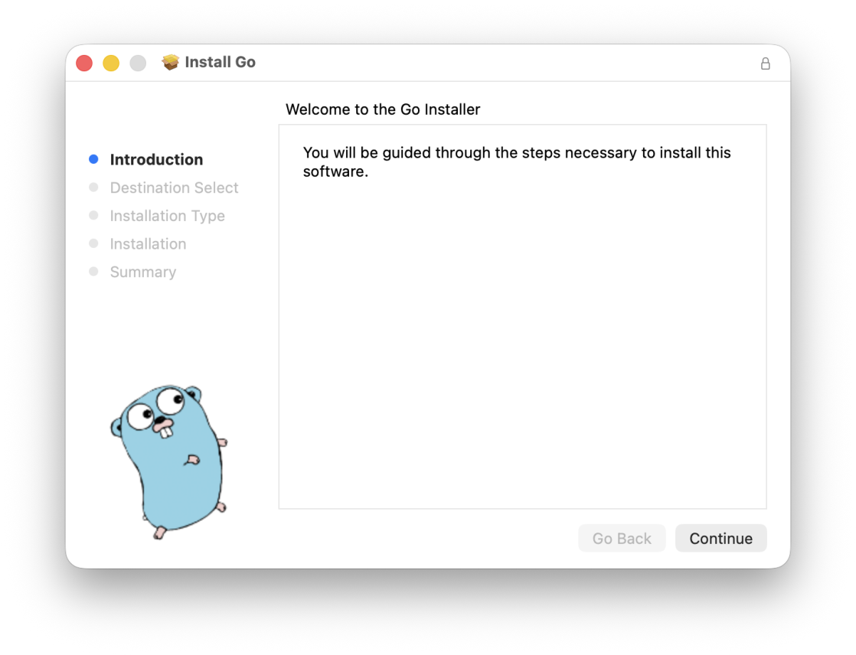
1. Download and Install Go Compiler on macOS (I)
https://go.dev/doc/install

Slide 6
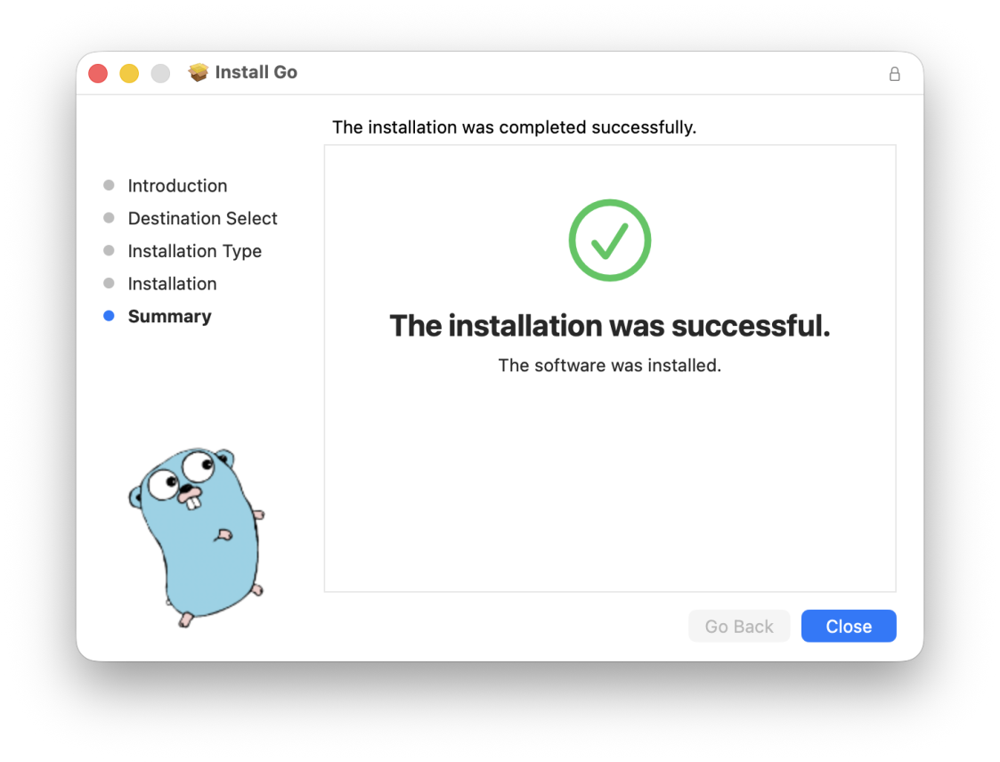
2. Download and Install Go Compiler on macOS (II)
Restart your MacBook

Slide 7
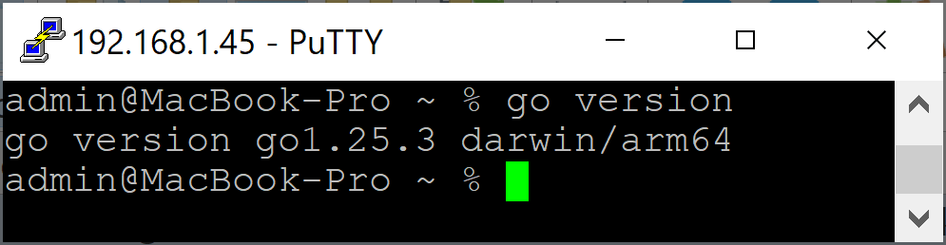
3. Verify Go Installation
go version

Slide 8


Slide 9
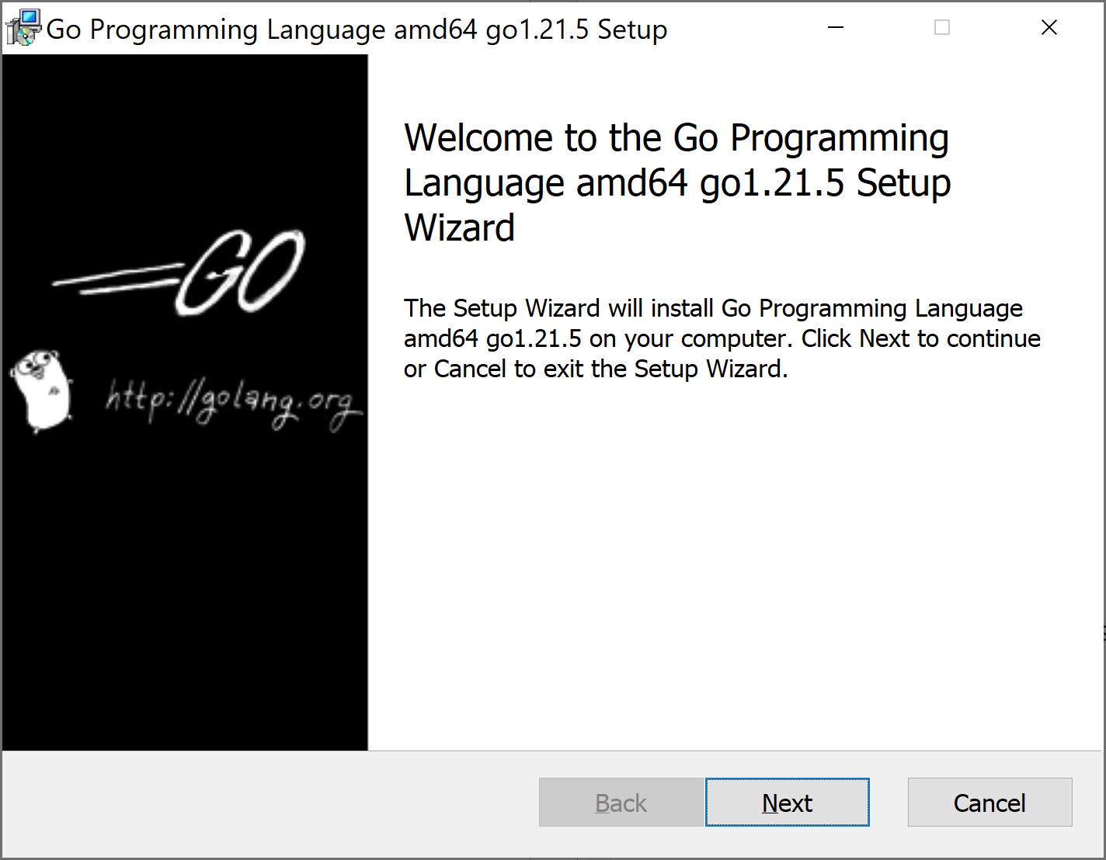
1. Download and Install Go Compiler on Windows
https://go.dev/doc/install

Slide 10
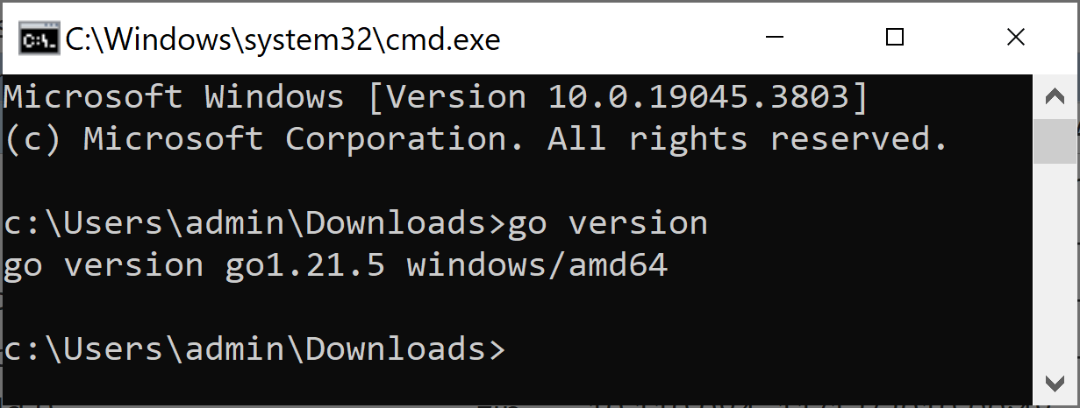
2. Verify Go Installation
go version

Slide 11
3. Install Go IDE
https://code.visualstudio.com/
https://marketplace.visualstudio.com/items?itemName=golang.go
https://go.dev/doc/editors

Slide 13
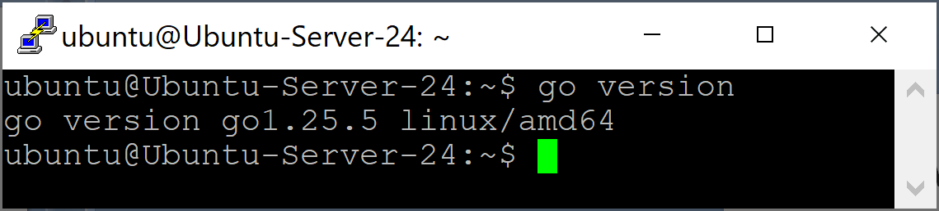
1. Download and Install Go Compiler on Ubuntu
https://go.dev/dl/
wget https://go.dev/dl/go1.25.5.linux-amd64.tar.gz
https://go.dev/doc/install
rm -rf /usr/local/go
sudo tar -C /usr/local -xzf go1.25.5.linux-amd64.tar.gz
export PATH=$PATH:/usr/local/go/bin
go version

Slide 15
1. Create Hello World [1]
package main
import "fmt"
func main() {
fmt.Println("Hello NHBien!")
}

Slide 16
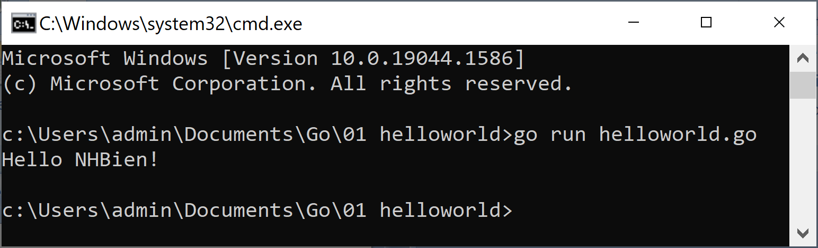
2. Run the Hello World
go run helloworld.go

Slide 17
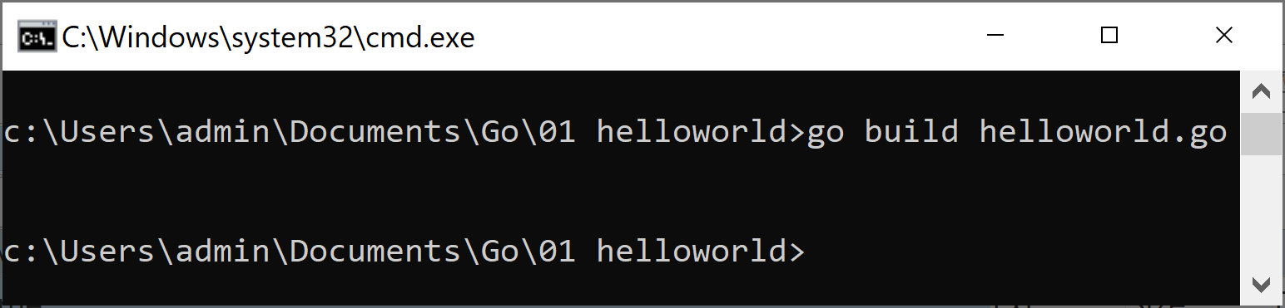
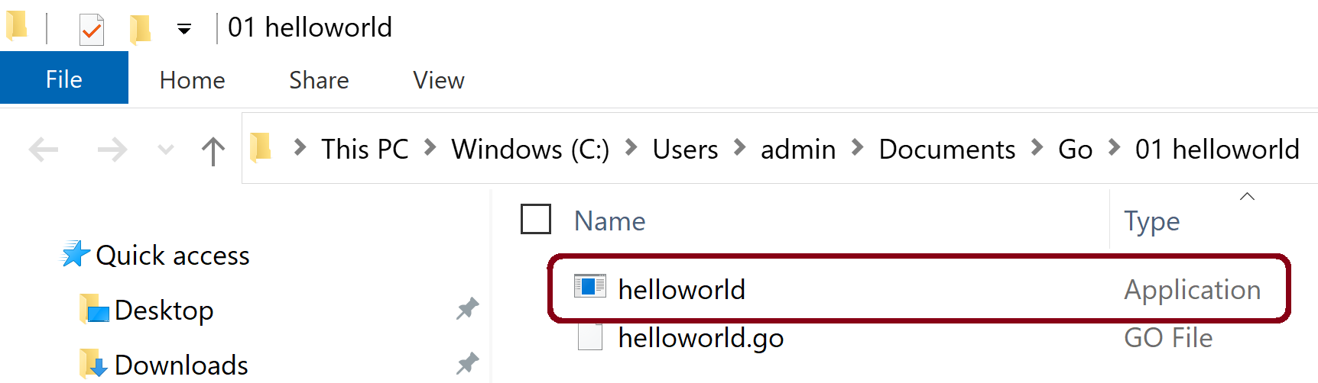
3. Build the Hello World
Go is a compiled language.
Create an executable binary file called helloworld that can be run any time.
go build helloworld.go

Slide 18
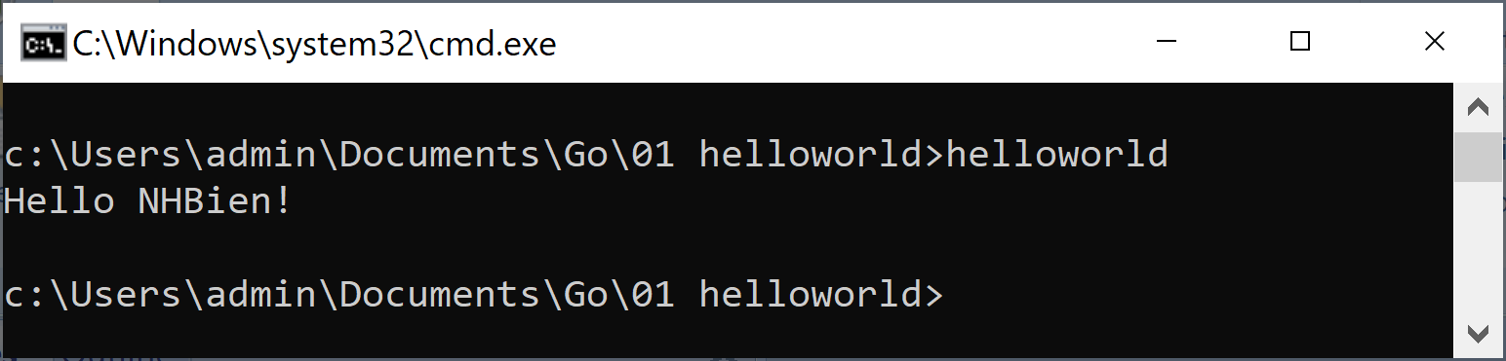
4. Run the Binary File
helloworld

Slide 20
Why Go? [2]
We wanted a language with the safety and performance of statically compiled languages such as C++ and Java, but the lightness and fun of dynamically typed interpreted languages such as Python.
Large programs compile in seconds with a single command.
Detail: https://go.dev/doc/faq#Origins

Slide 21
Primitive Types
package main
import (
"fmt"
"time"
)
func main() {
fmt.Println(1 + 3)
fmt.Println(2.71828)
fmt.Println(1 == 3) // false
fmt.Println("hello, world")
fmt.Println(time.Now())
fmt.Println(complex(1, 2)) // (1+2i)
}

Slide 22
Variables & Assignments [1]
A variable is a piece of storage containing a value.
The value held by a variable is updated by an assignment statement, which in its simplest form has a variable on the left of the = sign and an expression on the right.
A var declaration creates a variable of a particular type, attaches a name to it, and sets its initial value.
package main
import (
"fmt"
)
func main() {
var b, f, s = true, 2.3, "four" // bool, float64, string
fmt.Println(b)
fmt.Println(f)
fmt.Println(s)
}

Slide 23
Short Variable Declaration
Within a function, an alternate form called a short variable declaration may be used to declare and initialize local variables.
It takes the form name := expression, and the type of name is determined by the type of expression.
package main
import (
"fmt"
"math/rand"
)
func main() {
freq := rand.Float64() * 3.0
fmt.Println(freq)
}

Slide 24
Variable Declaration Block
https://www.golangprograms.com/go-language/variables.html
Variables declaration can be grouped together into blocks for greater readability and code quality.
const (
lenWidth = 8
)
var (
write = []byte("hello world")
width = uint64(len(write)) + lenWidth
)
fmt.Println(lenWidth)
fmt.Println(write)
fmt.Println(width)

Slide 25
Pointers
A pointer value is the address of a variable.
A pointer is thus the location at which a value is stored.
Not every value has an address, but every variable does.
With a pointer, we can read or update the value of a variable indirectly, without using or even knowing the name of the variable, if indeed it has a name.
package main
import "fmt"
func main() {
x := 1
p := &x // p, of type *int, points to x
fmt.Println(*p) // "1"
*p = 2 // equivalent to x = 2
fmt.Println(x) // "2"
}

Slide 26
The new Function
The expression new(T) creates an unnamed variable of type T, initializes it to the zero value of T, and returns its address, which is a value of type *T.
package main
import "fmt"
func main() {
p := new(int) // p, of type *int, points to an unnamed int variable
fmt.Println(*p) // "0"
*p = 2 // sets the unnamed int to 2
fmt.Println(*p) // "2"
}

Slide 27
Declarations
A declaration names a program entity and specifies some or all of its properties.
There are four major kinds of declarations: var, const, type, and func.
package main
import "fmt"
func main() {
var s string
s = "Ngo Huy Bien"
fmt.Println(s)
const boilingF = 212.0
var f = boilingF
var c = (f - 32) * 5 / 9
fmt.Printf("boiling point = %g°F or %g°C\n", f, c)
}

Slide 28
iota Keyword
The iota keyword represents successive integer constants 0, 1, 2,… and increments after each const specification.
It resets to 0 whenever the word const appears in the source code.
const (
C0 = iota
C1 = 2
C2 = 3
C3 = iota + C1 + C2
C4 = iota
) fmt.Println(C0, C1, C2, C3, C4) // "0 2 3 8 4" const (
D1 = iota
D2 = iota
D3 = iota
) fmt.Println(D1, D2, D3) // "0 1 2"

Slide 29
string
func main() {
name := "Ngô Huy Biên"
fmt.Printf("name: %s\n", name)
fmt.Printf("len: %d\n", len(name))
fmt.Printf("rune count: %d\n", utf8.RuneCountInString(name))
}

Slide 30
Condition
func main() {
num := 7
if num%2 == 0 {
fmt.Printf("%d is even", num)
} else {
fmt.Printf("%d is odd", num)
}
}

Slide 31
Loop
func main() {
i := 1
for i <= 3 {
fmt.Println(i)
i = i + 1
}
for j := 7; j <= 9; j++ {
fmt.Println(j)
}
for {
fmt.Println("loop")
break
}
}

Slide 33
Functions
A function declaration has a name, a list of parameters, an optional list of results, and a body.
package main
import (
"fmt"
"math"
)
func hypot(x, y float64) float64 {
return math.Sqrt(x*x + y*y)
}
func main() {
fmt.Println(hypot(3, 4)) // "5"
}

Slide 34
The defer keyword
Syntactically, a defer statement is an ordinary function or method call prefixed by the keyword defer.
The function and argument expressions are evaluated when the statement is executed, but the actual call is deferred until the function that contains the defer statement has finished, whether normally, by executing a return statement or falling off the end, or abnormally, by panicking.
func proverbs(name string) error {
f, err := os.Create(name)
if nil != err {
return err
}
defer f.Close()
_, err = fmt.Fprintln(f, "Errors are values.")
if nil != err {
return err
}
_, err = fmt.Fprintln(f, "Don't just check errors, handle them gracefully.")
return err
}

Slide 35
Full Code: defer.go
package main
import (
"fmt"
"os"
)
func proverbs(name string) error {
f, err := os.Create(name)
if nil != err {
return err
}
defer f.Close()
_, err = fmt.Fprintln(f, "Errors are values.")
if nil != err {
return err
}
_, err = fmt.Fprintln(f, "Don't just check errors, handle them gracefully.")
return err
}
func main() {
// Change proverbs.txt to read-only to simulate an error.
err := proverbs("C:\\Users\\admin\\Downloads\\proverbs.txt")
fmt.Println(err)
}

Slide 37
Arrays
An array is a fixed-length sequence of zero or more elements of a particular type.
func main() {
var a [3]int // array of 3 integers
a[0] = 1
a[1] = 3
a[2] = 4
fmt.Println(a[0]) // print the first element
fmt.Println(a[len(a)-1])
// print the last element, a[2]
// Print the indices and elements.
for i, v := range a {
fmt.Printf("%d %d\n", i, v)
}
}

Slide 38
Slides
Slices represent variable-length sequences whose elements all have the same type.
A slice type is written []T, where the elements have type T; it looks like an array type without a size.
primes := [6]int{2, 3, 5, 7, 11, 13}
var s []int = primes[1:4]
fmt.Println(s)

Slide 39
Slide Components
A slice has three components: a pointer, a length, and a capacity.
The pointer points to the first element of the array that is reachable through the slice, which is not necessarily the array’s first element.
The length is the number of slice elements; it can’t exceed the capacity, which is usually the number of elements between the start of the slice and the end of the underlying array.

Slide 40
Example Slides
func main() {
primes := [6]int{2, 3, 5, 7, 11, 13}
var s []int = primes[1:4]
fmt.Println(s)
months := [...]string{1: "January", 2: "February", 3: "March",
4: "April", 5: "May", 6: "June",
7: "July", 8: "August", 9: "September",
10: "October", 11: "November", 12: "December"}
Q2 := months[4:7]
fmt.Println(Q2)
summer := months[6:9]
fmt.Println(summer)
fmt.Printf("Q2 len: %d Q2 cap: %d\n", len(Q2), cap(Q2))
fmt.Printf("summer len: %d summer cap: %d\n", len(summer), cap(summer))
}

Slide 41
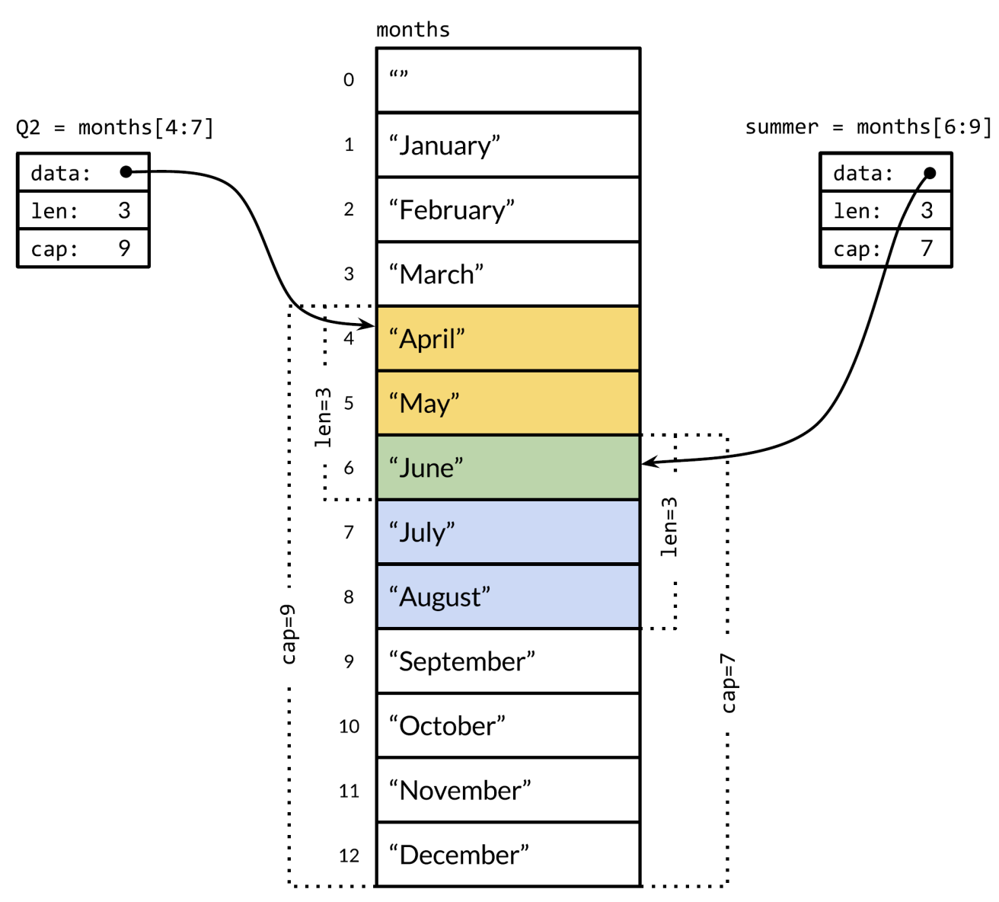
Slides and Underlying Array

Slide 42
Maps
The hash table is an unordered collection of key/value pairs in which all the keys are distinct, and the value associated with a given key can be retrieved, updated, or removed using a constant number of key comparisons on the average, no matter how large the hash table.
In Go, a map is a reference to a hash table, and a map type is written map[K]V, where K and V are the types of its keys and values.
ages := make(map[string]int)
ages["alice"] = 31
ages["charlie"] = 34
fmt.Println(ages["alice"])

Slide 43
range
func main() {
nums := []int{2, 3, 4}
// range on arrays and slices provides both the index and value for each entry.
for i, num := range nums {
if num == 3 {
fmt.Println("index:", i)
}
}
sum := 0
for _, num := range nums {
sum += num
}
fmt.Println("sum:", sum)
}

Slide 44
Structs
A struct is an aggregate data type that groups together zero or more named values of arbitrary types as a single entity.
Each value is called a field.
package main
import (
"fmt"
"math"
)
func hypot(x, y float64) float64 {
return math.Sqrt(x*x + y*y)
}
func main() {
fmt.Println(hypot(3, 4)) // "5"
}

Slide 46
Function Values
Functions are first-class values in Go: like other values, function values have types, and they may be assigned to variables or passed to or returned from functions.
package main
import (
"fmt"
)
func square(n int) int { return n * n }
func negative(n int) int { return -n }
func product(m, n int) int { return m * n }
func main() {
f := square
fmt.Println(f(3)) // "9"
f = negative
fmt.Println(f(3)) // "-3"
fmt.Printf("%T\n", f) // "func(int) int"
// f = product // compile error: can't assign f(int, int) int to f(int) int
}

Slide 47
Methods
A method is a function associated with a particular type.
A method is declared with a variant of the ordinary function declaration in which an extra parameter appears before the function name.
The parameter attaches the function to the type of that parameter.
type Point struct{ X, Y float64 }
// traditional function
func Distance(p, q Point) float64 {
return math.Hypot(q.X-p.X, q.Y-p.Y)
}
// same thing, but as a method of the Point type
// p is an argument providing access to the type properties in the method
func (p Point) Distance(q Point) float64 {
return math.Hypot(q.X-p.X, q.Y-p.Y)
}

Slide 48
Full Code: methods.go
package main
import (
"fmt"
"math"
)
type Point struct{ X, Y float64 }
// traditional function
func Distance(p, q Point) float64 {
return math.Hypot(q.X-p.X, q.Y-p.Y)
}
// same thing, but as a method of the Point type
// p is an argument providing access to the type properties in the method
func (p Point) Distance(q Point) float64 {
return math.Hypot(q.X-p.X, q.Y-p.Y)
}
func main() {
p := Point{1, 2}
q := Point{4, 6}
fmt.Println(Distance(p, q)) // "5", function call
fmt.Println(p.Distance(q)) // "5", method call
}

Slide 49
Pointer Receiver
Because calling a function makes a copy of each argument value, if a function needs to update a variable, or if an argument is so large that we wish to avoid copying it, we must pass the address of the variable using a pointer.
type Point struct{ X, Y float64 }
func (p Point) ScaleBy1(factor float64) {
p.X *= factor
p.Y *= factor
}
func (p *Point) ScaleBy2(factor float64) {
p.X *= factor
p.Y *= factor
}

Slide 50
Call Method with Pointer Receiver
The name of this method is (*Point).ScaleBy2.
The parentheses are necessary; without them, the expression would be parsed as *(Point.ScaleBy2).
func main() {
p := Point{1, 2}
p.ScaleBy1(3.0)
fmt.Println(p.X)
fmt.Println(p.Y)
q := &p
q.ScaleBy2(3.0)
fmt.Println(p.X)
fmt.Println(p.Y)
}

Slide 51
Interface Types [1, 2]
An interface type specifies a set of methods that a concrete type must possess to be considered an instance of that interface.
package main
import (
"fmt"
"strings"
)
type talker interface {
talk() string
}

Slide 52
Interface Satisfaction (I)
A type satisfies an interface if it possesses all the methods the interface requires.
type martian struct{}
func (m martian) talk() string {
return "nack nack"
}
type laser int
func (l laser) talk() string {
return strings.Repeat("pew ", int(l))
}

Slide 53
Interface Satisfaction (II)
func shout(t talker) {
louder := strings.ToUpper(t.talk())
fmt.Println(louder)
}
func main() {
var t talker
t = martian{}
shout(t)
t = laser(2)
shout(t)
}

Slide 55
Package System
The purpose of any package system is to make the design and maintenance of large programs practical by grouping related features together into units that can be easily understood and changed, independent of the other packages of the program.
Packages also provide encapsulation by controlling which names are visible or exported outside the package.
When we change a file, we must recompile the file's package and potentially all the packages that depend on it.

Slide 56
The Package Declaration
A package declaration is required at the start of every Go source file.
Its main purpose is to determine the default identifier for that package (called the package name) when it is imported by another package.
Every file of the math/rand package starts with package rand, so when you import this package, you can access its members as rand.Int.
package main
import (
"fmt"
"math/rand"
)
func main() {
fmt.Println(rand.Int())
}

Slide 57
Package Main
When you build reusable pieces of code, you will develop a package as a shared library.
But when you develop executable programs, you will use the package “main” for making the package as an executable program.
The package “main” tells the Go compiler that the package should compile as an executable program instead of a shared library.
The main function in the package “main” will be the entry point of our executable program.
When you build shared libraries, you will not have any main package and main function in the package.

Slide 59
What are Goroutines?
In Go, each concurrently executing activity is called a goroutine.
When a program starts, its only goroutine is the one that calls the main function, so we call it the main goroutine.
New goroutines are created by the go statement.
f() // call f(); wait for it to return
go f() // create a new goroutine that calls f(); don't wait
Goroutines are similar to coroutines, fibers, processes, or threads in other languages, although they're not quite the same as any of those.

Slide 60
Concurrency
What are the outputs?
func ping(i int) {
fmt.Println("Hello", i)
}
func main() {
for i := 1; i <= 5; i++ {
go ping(i)
}
time.Sleep(1 * time.Second)
}

Slide 61
A Small Change
What are the outputs?
func ping(i int) {
fmt.Println("Hello", i)
}
func main() {
for i := 1; i <= 5; i++ {
go ping(i)
}
// time.Sleep(1 * time.Second)
}

Slide 62
sync.WaitGroup
sync.WaitGroup is used to wait for all the goroutines launched here to finish.
func ping(i int) {
fmt.Println("Hello", i)
} func main() { var wg sync.WaitGroup
for i := 1; i <= 5; i++ {
wg.Add(1)
go func(x int) {
defer wg.Done()
ping(x)
}(i)
}
wg.Wait()
}

Slide 63
Race Conditions (I)
A race condition is a situation in which the program does not give the correct result for some interleavings of the operations of multiple goroutines.
var aliveServers int
var deadServers int
func ping(num int) {
if num%2 == 0 {
aliveServers++
} else {
deadServers++
}
}

Slide 64
Race Conditions (II)
func main() {
var wg sync.WaitGroup
for i := 1; i <= 10000; i++ {
wg.Add(1)
go func(x int) {
defer wg.Done()
ping(x)
}(i)
}
wg.Wait()
fmt.Println("Alive servers: ", aliveServers)
fmt.Println("Dead servers:", deadServers)
}

Slide 65
Concurrency-Safe Program
Consider a function that works correctly in a sequential program. That function is concurrency-safe if it continues to work correctly even when called concurrently, that is, from two or more goroutines with no additional synchronization.
We can generalize this notion to a set of collaborating functions, such as the methods and operations of a particular type.
A type is concurrency-safe if all its accessible methods and operations are concurrency-safe.
We can make a program concurrency-safe without making every concrete type in that program concurrency-safe.
We avoid concurrent access to most variables either by confining them to a single goroutine or by maintaining a higher-level invariant of mutual exclusion.

Slide 66
Mutual Exclusion: sync.Mutex (I)
Each time a goroutine accesses the variables, it must call the mutex's Lock method to acquire an exclusive lock.
If some other goroutine has acquired the lock, this operation will block until the other goroutine calls Unlock and the lock becomes available again.
The mutex guards the shared variables.
var aliveServers int
var deadServers int
var mu sync.Mutex
func ping(num int) {
mu.Lock()
defer mu.Unlock()
if num%2 == 0 {
aliveServers++
} else {
deadServers++
}
}

Slide 67
Mutual Exclusion: sync.Mutex (II)
func main() {
var wg sync.WaitGroup
for i := 1; i <= 10000; i++ {
wg.Add(1)
go func(x int) {
defer wg.Done()
ping(x)
}(i)
}
wg.Wait()
fmt.Println("Alive servers: ", aliveServers)
fmt.Println("Dead servers:", deadServers)
}

Slide 68
Counting (I)
var aliveServers int
var deadServers int
var mu sync.Mutex
func ping(num int) {
mu.Lock()
defer mu.Unlock()
if num%2 == 0 {
aliveServers++
} else {
deadServers++
}
}

Slide 69
Counting (II)
func main() {
for i := 1; i <= 10000; i++ {
go func(x int) {
ping(x)
}(i)
}
for {
mu.Lock()
if deadServers >= 300 || (aliveServers+deadServers) == 10000 {
break
}
mu.Unlock()
time.Sleep(50 * time.Millisecond)
}

Slide 70
Counting (III)
if deadServers >= 300 {
fmt.Println("Status: Failure.")
fmt.Println("Alive servers: ", aliveServers)
fmt.Println("Dead servers:", deadServers)
} else {
fmt.Println("Status: OK.")
fmt.Println("Alive servers: ", aliveServers)
fmt.Println("Dead servers:", deadServers)
}
}

Slide 71
sync.NewCond (I)
var aliveServers int
var deadServers int
var mu sync.Mutex
var cond = sync.NewCond(&mu)
func ping(num int) {
mu.Lock()
defer mu.Unlock()
if num%2 == 0 {
aliveServers++
} else {
deadServers++
}
cond.Broadcast()
}

Slide 72
sync.NewCond (II)
func main() {
for i := 1; i <= 10000; i++ {
go func(x int) {
ping(x)
}(i)
}
mu.Lock()
for deadServers < 300 && (aliveServers+deadServers) != 10000 {
cond.Wait()
}
mu.Unlock()

Slide 73
sync.NewCond (III)
if deadServers >= 300 {
fmt.Println("Status: Failure.")
fmt.Println("Alive servers: ", aliveServers)
fmt.Println("Dead servers:", deadServers)
} else {
fmt.Println("Status: OK.")
fmt.Println("Alive servers: ", aliveServers)
fmt.Println("Dead servers:", deadServers)
}
}

Slide 75
Channels
If goroutines are the activities of a concurrent Go program, channels are the connections between them.
A channel is a communication mechanism that lets one goroutine send values to another goroutine.
Each channel is a conduit for values of a particular type, called the channel's element type.
To create a channel, we use the built-in make function:
ch := make(chan int) // ch has type 'chan int'

Slide 76
Channel Operations
A channel has two principal operations, send and receive, collectively known as communications.
ch < x // a send statement
x = < ch // a receive expression in an assignment statement
< ch // a receive statement; result is discarded
To close a channel, we call the built-in close function:
close(ch)

Slide 77
Producer-Consumer
func main() {
c := make(chan string) for i := 1; i <= 5; i++ {
go doWork(i, c)
} for {
v := <-c
fmt.Println(v)
}
}
func doWork(num int, c chan string) {
for {
time.Sleep(time.Duration(rand.Intn(1000)) * time.Millisecond)
value := rand.Intn(100)
result := fmt.Sprintf("Worker %d returns: %d", num, value)
c <- result
}
}

Slide 78
What Happens?
func main() {
c := make(chan string) for i := 1; i <= 5; i++ {
go doWork(i, c)
} for {
v := <-c
fmt.Println(v)
}
} func doWork(num int, c chan string) {
for {
time.Sleep(time.Duration(rand.Intn(1000)) * time.Millisecond)
value := rand.Intn(100)
result := fmt.Sprintf("Worker %d returns: %d", num, value)
c <- result
break
}
}

Slide 79
Counting with Channel (I)
var cAliveServers = make(chan int)
var cDeadServers = make(chan int)
func ping(num int) {
if num%2 == 0 {
cAliveServers <- 1
} else {
cDeadServers <- 1
}
}
func main() {
for i := 1; i <= 10000; i++ {
go func(x int) {
ping(x)
}(i)
}

Slide 80
Counting with Channel (II)
aliveServers := 0
deadServers := 0
for {
countAlive := <-cAliveServers
aliveServers = aliveServers + countAlive
countDead := <-cDeadServers
deadServers = deadServers + countDead
if deadServers >= 300 {
break
}
if aliveServers+deadServers == 10000 {
break
}
}

Slide 81
Counting with Channel (III)
if deadServers >= 300 {
fmt.Println("Status: Failure.")
fmt.Println("Alive servers: ", aliveServers)
fmt.Println("Dead servers:", deadServers)
} else {
fmt.Println("Status: OK.")
fmt.Println("Alive servers: ", aliveServers)
fmt.Println("Dead servers:", deadServers)
}
}

Slide 82
select
aliveServers := 0
deadServers := 0
for count := 1; count <= 10000; count++ {
select {
case <-cAliveServers:
aliveServers++
case <-cDeadServers:
deadServers++
}
if deadServers >= 300 {
break
}
}

Slide 83
select
A select waits until a communication for some case is ready to proceed.
It then performs that communication and executes the case's associated statements; the other communications do not happen.
It's as if select is looking at both channels at once and takes action when it sees something happen on either of them.
A select with no cases, select{}, waits forever.
A select may have a default, which specifies what to do when none of the other communications can proceed immediately.

Slide 85
Timer
func main() {
println("Started")
go periodic()
time.Sleep(5 * time.Second) // wait for a while so we can observe what ticker does
}
func periodic() {
count := 1
for {
println("Tick", count)
count++
time.Sleep(1 * time.Second)
}
}

Slide 86
Stoppable Timer (I)
var done bool
var mu sync.Mutex
func main() {
println("Started")
go periodic()
time.Sleep(3 * time.Second)
mu.Lock()
done = true
mu.Unlock()
println("Timer stopped.")
}

Slide 87
Stoppable Timer (II)
func periodic() {
count := 1
for {
println("Tick", count)
count++
time.Sleep(1 * time.Second)
mu.Lock()
if done {
return
}
mu.Unlock()
}
}

Slide 88
Ticker
func main() {
ticker := time.NewTicker(1 * time.Second)
done := make(chan bool)
go func() {
for {
select {
case <-done:
return
case t := <-ticker.C:
fmt.Println("Tick at", t)
}
}
}()
time.Sleep(5 * time.Second)
ticker.Stop()
done <- true
fmt.Println("Ticker stopped")
}

Slide 89
time.After
func main() {
println("Started")
go periodic()
select {
case <-time.After(5 * time.Second): // No side effects. No blocks.
fmt.Println("There's no more time to this. Exiting!")
return
}
}
func periodic() {
count := 1
for {
println("Tick", count)
count++
time.Sleep(1 * time.Second)
}
}

Slide 91
Modules
https://go.dev/ref/mod#go-mod-init
go mod init kvs/shared
The go mod init command initializes and writes a new go.mod file in the current directory, in effect creating a new module rooted at the current directory.
The go.mod file must not already exist.
go.mod file: The file that defines a module’s path, requirements, and other metadata. Appears in the module’s root directory.
init accepts one optional argument, the module path for the new module.
A module path is the canonical name for a module, declared with the module directive in the module’s go.mod file.

Slide 92
1. Create a Module
https://go.dev/doc/tutorial/create-module
mkdir greetings
cd greetings
go mod init example.com/greetings

Slide 93
2. Create greetings.go
package greetings
import "fmt"
// Hello returns a greeting for the named person.
func Hello(name string) string {
// Return a greeting that embeds the name in a message.
message := fmt.Sprintf("Hi, %v. Welcome!", name)
return message
}

Slide 94
3. Create a Module Caller
cd ..
mkdir hello
cd hello
go mod init example.com/hello

Slide 95
4. Create hello.go
package main
import (
"fmt"
"example.com/greetings"
)
func main() {
// Get a greeting message and print it.
message := greetings.Hello("Bien")
fmt.Println(message)
}

Slide 96
5. Use Local Module
For production use, you’d publish the example.com/greetings module from its repository (with a module path that reflected its published location), where Go tools could find it to download it.
For now, because you haven't published the module yet, you need to adapt the example.com/hello module so it can find the example.com/greetings code on your local file system.
go mod edit -replace example.com/greetings=../greetings
go mod tidy

Slide 97
6. Run hello.go
go run .

Slide 99
Exported Identifier
In Go packages, all identifiers will be exported to other packages if the first letter of the identifier name starts with an uppercase letter.

Slide 100
Install Third-Party Packages
go get gopkg.in/mgo.v2

Slide 101
GOROOT
GOROOT is a variable that defines where your Go SDK is located.
You do not need to change this variable, unless you plan to use different Go versions.

Slide 102
GOPATH
GOPATH is a variable that defines the root of your workspace.
By default, the workspace directory is a directory that is named go within your user home directory (~/go for Linux and macOS, %USERPROFILE%/go for Windows).
GOPATH stores your code base and all the files that are necessary for your development.

Slide 103
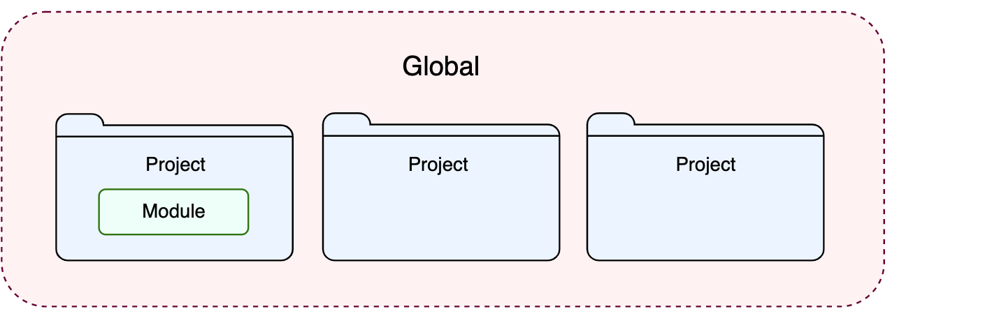
Configuring GOPATH
You can configure GOPATH for the following scopes:
Global GOPATH: settings apply to all projects of a specific installation of GoLand.
Project GOPATH: settings apply only to the current project.
Module GOPATH: settings apply only to one module. A module can have an SDK that is different from those configured for a project. They can also carry a specific technology or a framework.

Slide 104
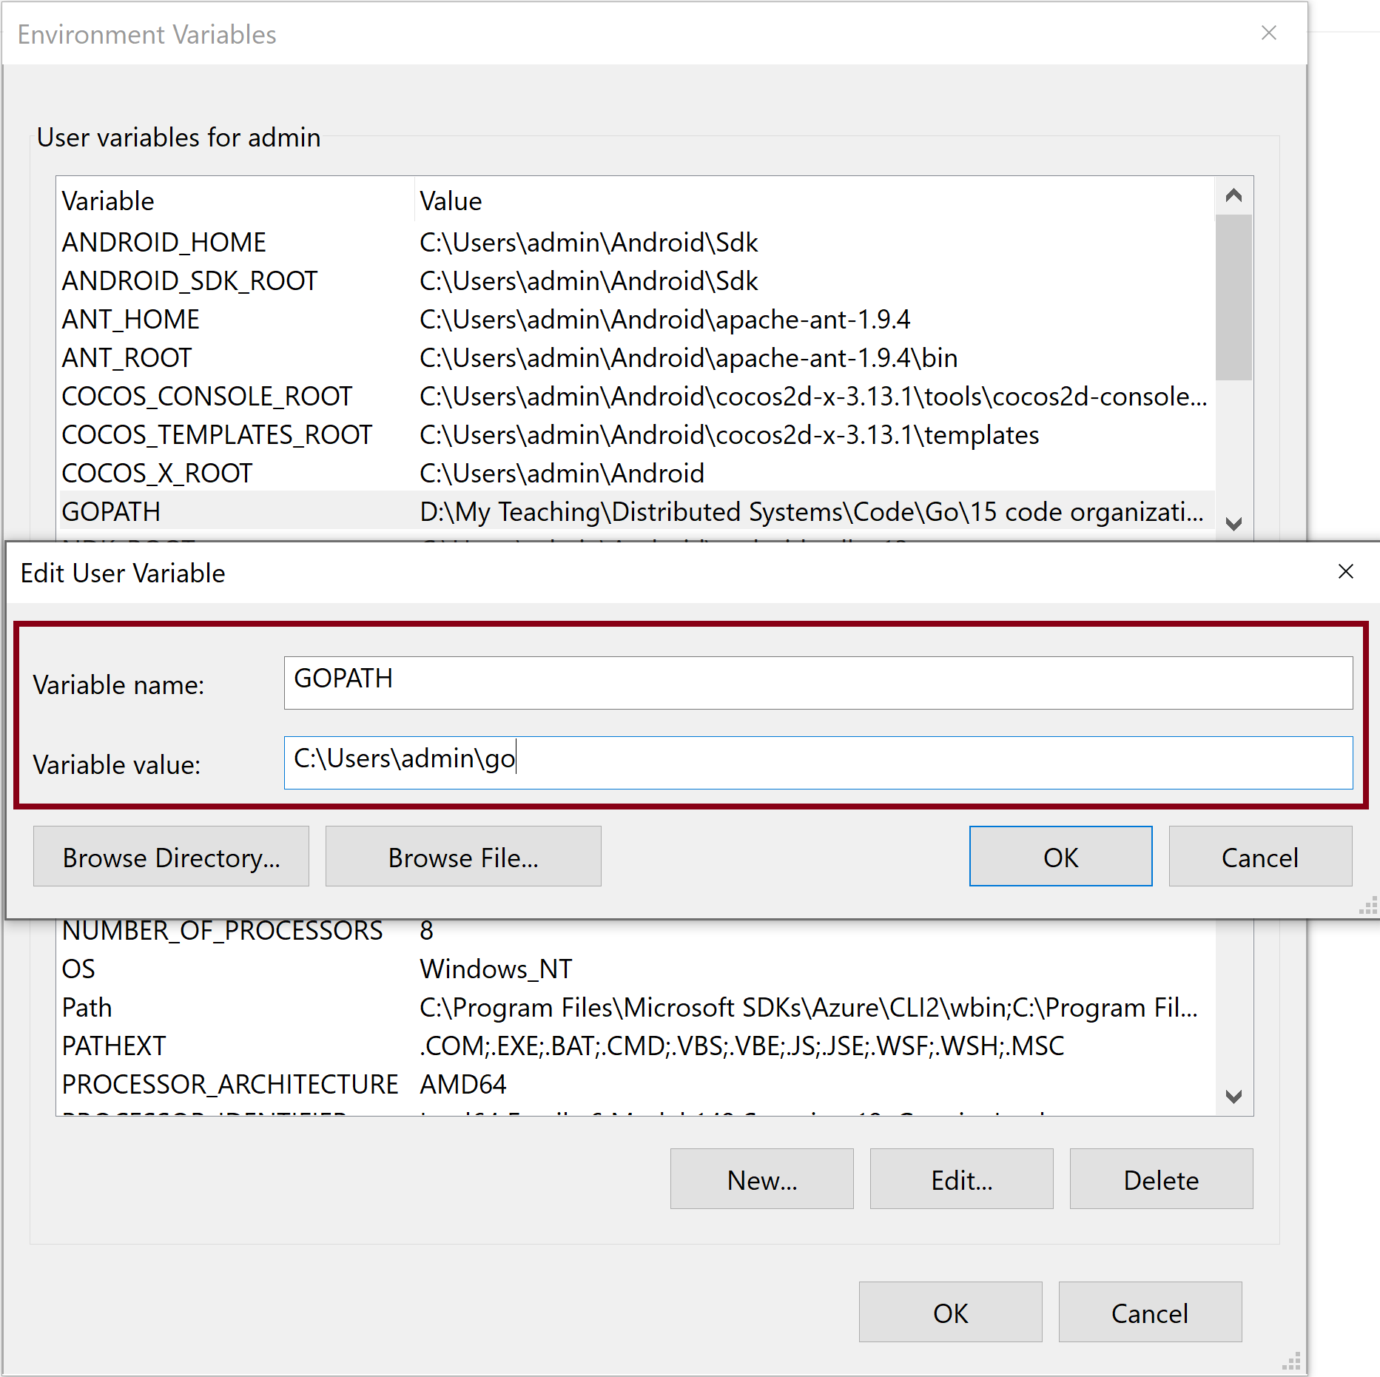
Configuring Global GOPATH on Windows

Slide 105
Go Compilation Speed [1]
Go compilation is notably faster than most other compiled languages, even when building from scratch.
There are three main reasons for the compiler's speed.
First, all imports must be explicitly listed at the beginning of each source file, so the compiler does not have to read and process an entire file to determine its dependencies.
Second, the dependencies of a package form a directed acyclic graph, and because there are no cycles, packages can be compiled separately and perhaps in parallel.
Finally, the object file for a compiled Go package records export information not just for the package itself, but for its dependencies too. When compiling a package, the compiler must read one object file for each import but need not look beyond these files.

Slide 107
Print Errors
func main() {
log.New(os.Stderr, "", 0).Println("Error 1")
fmt.Fprintln(os.Stderr, "Error 2")
// Calling the Errorf() function with verb
// %q which is used for a single-quoted character
fmt.Println(fmt.Errorf("%q\n", "Error 3").Error())
}

Slide 108
The go test Tool
The go test subcommand is a test driver for Go packages that are organized according to certain conventions.
In a package directory, files whose names end with _test.go are not part of the package ordinarily built by go build but are a part of it when built by go test.

Slide 109
Special Test Functions
A test function, which is a function whose name begins with Test, exercises some program logic for correct behavior; go test calls the test function and reports the result, which is either PASS or FAIL.
A benchmark function has a name beginning with Benchmark and measures the performance of some operation; go test reports the mean execution time of the operation.
And an example function, whose name starts with Example, provides machine-checked documentation.
The go test tool scans the *_test.go files for these special functions, generates a temporary main package that calls them all in the proper way, builds and runs it, reports the results, and then cleans up.

Slide 110
1. Create greetings_test.go
package greetings
import (
"regexp"
"testing"
)
// TestHelloName calls greetings.Hello with a name, checking
// for a valid return value.
func TestHelloName(t *testing.T) {
name := "NHBien"
want := regexp.MustCompile(`\b` + name + `\b`)
msg := Hello("NHBien")
if !want.MatchString(msg) {
t.Fatalf(`Hello("NHBien") = %q, want match for %#q`, msg, want)
}
}

Slide 111
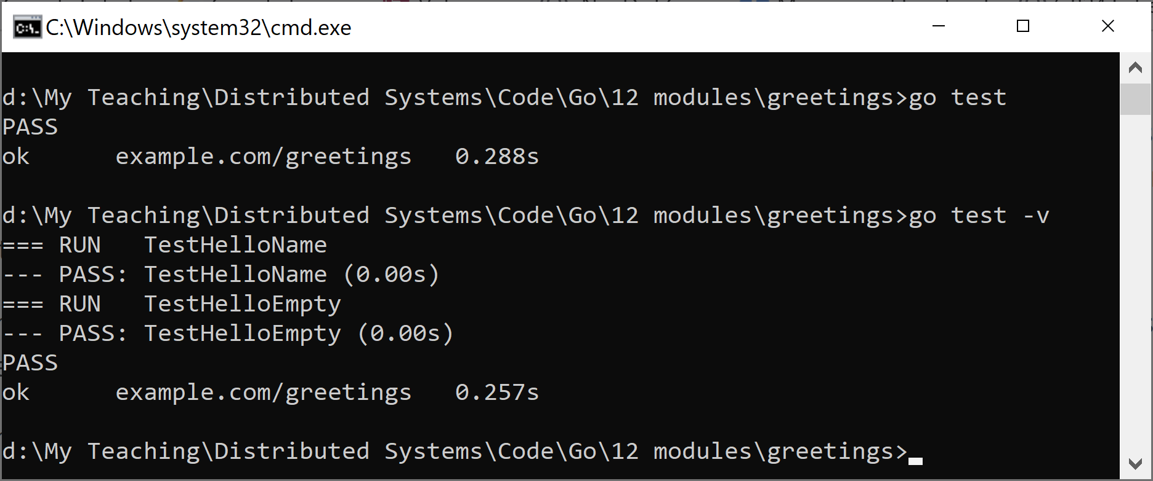
2. Run greetings_test.go
go test
go test -v

Slide 113
Does Go have a runtime?
https://go.dev/doc/faq#runtime
Go does have an extensive library, called the runtime, that is part of every Go program. The runtime library implements garbage collection, concurrency, stack management, and other critical features of the Go language. Although it is more central to the language, Go's runtime is analogous to libc, the C library
It is important to understand, however, that Go's runtime does not include a virtual machine, such as is provided by the Java runtime. Go programs are compiled ahead of time to native machine code (or JavaScript or WebAssembly, for some variant implementations).
Thus, although the term is often used to describe the virtual environment in which a program runs, in Go the word “runtime” is just the name given to the library providing critical language services.

Slide 114
Why does Go not have exceptions?
https://go.dev/doc/faq#exceptions
We believe that coupling exceptions to a control structure, as in the try-catch-finally idiom, results in convoluted code.
It also tends to encourage programmers to label too many ordinary errors, such as failing to open a file, as exceptional.
Go takes a different approach.
For plain error handling, Go's multi-value returns make it easy to report an error without overloading the return value.
A canonical error type, coupled with Go's other features, makes error handling pleasant but quite different from that in other languages.
Go also has a couple of built-in functions to signal and recover from truly exceptional conditions.

Slide 115
Is Go an object-oriented language?
https://go.dev/doc/faq#Is_Go_an_object-oriented_language
Yes and no. Although Go has types and methods and allows an object-oriented style of programming, there is no type hierarchy.
The concept of “interface” in Go provides a different approach that we believe is easy to use and in some ways more general.
There are also ways to embed types in other types to provide something analogous—but not identical—to subclassing. Moreover, methods in Go are more general than in C++ or Java: they can be defined for any sort of data, even built-in types such as plain, “unboxed” integers. They are not restricted to structs (classes).
Also, the lack of a type hierarchy makes “objects” in Go feel much more lightweight than in languages such as C++ or Java.

Slide 116

Further Reading
https://go.dev/tour/welcome/1
https://gobyexample.com/
https://cacm.acm.org/research/the-go-programming-language-and-environment/

Slide 117

Thank You & See You Again

